Slide 1
Unit-2 – Baseband coding basics
1 | Types of Antennas-Dipole, groundplane, loop, Helical, Patch antennas
2 | Antenna Characteristics- Impedance, directivity and gain, Effective area, Polarization, Bandwidth, Antenna factor
3 | Baseband Data Format and Protocol - Radio Communication Link Diagram, Code Hopping
4 | Baseband Coding-Digital systems, Wireless Microphone System
5 | RF Frequency and Bandwidth-factors Propagation Characteristics
6 | Modulation types, Modulation for digital event communication
7 | Continuous Digital Communication Advanced Digital Modulation
8 | Spread Spectrum-DSSS, Spread Spectrum-FHSS
9 | RFID-transceiver, Design issues for RFID
Baseband is the transmission of a signal in its original, unmodulated form

Slide 2

Antenna
Interface between the transmitter or the receiver and the propagation medium
Deciding factor →performance of a radio communication system.
Principal properties of antennas—directivity, gain, and radiation resistance —are the same whether referred to as transmitting or receiving.
The principle of reciprocity states that the power transferred between two antennas is the same, regardless of which is used for transmission or reception, if the generator and load impedances are conjugates of the transmitting and receiving antenna impedances in each case.
Antenna characteristics
primary concern in choosing an antenna type is its physical size
1. Antenna impedance
facilitates the transfer of power between the communication medium and the transmitter or receiver.
The antenna impedance is the load for the transmitter or the input impedance to the receiver.
It is composed of three parts—radiation resistance, loss resistance, and reactance.
Radiation resistance is a virtual resistance that, when multiplied by the square of the RMS current in the antenna at its feed point, equals the power radiated by the antenna in the case of a transmitter.

Slide 3
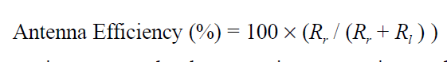
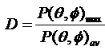
Antenna characteristics
Isotropic and omni https://www.youtube.com/watch?v=xAVH7AY50ns
Transmitter power delivered to an antenna will always be greater than the power radiated.
difference between the transmitter power and the radiated power is power dissipated in the resistance of the antenna conductor and in other losses.
The efficiency of an antenna is the ratio of the radiated power to the total power absorbed by the antenna.
Maximum power transfer between the antenna and transmitter or receiver will occur only when the impedance seen from the antenna terminals is the complex conjugate of the antenna impedance.
2. Directivity and gain
Relates to its radiation pattern. An antenna which radiates uniformly in all directions in three-dimensional space is called an isotropic antenna. Such an antenna doesn’t exist.
All real antennas radiate stronger in some directions than in others
It is defined as the power density of the antenna in its direction of maximum radiation in three-dimensional space divided by its average power density.
Directivity of the hypothetical isotropic radiator 1 or 0 dB
Directivity of a half-wave dipole antenna is 1.64 or 2.15 dB

Slide 4
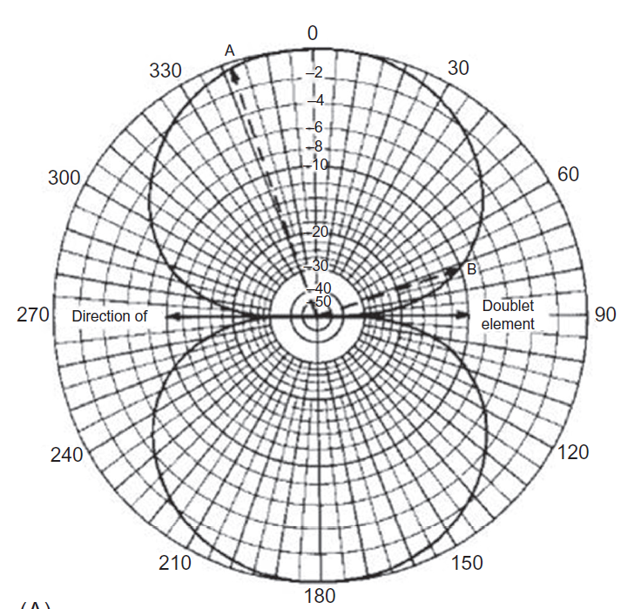
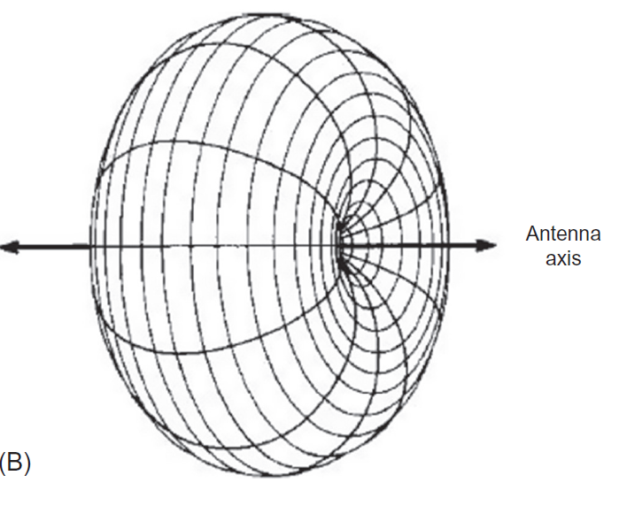
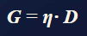
Antenna characteristics
Short dipole antenna (A) Directive pattern in plane containing antenna
and (B) solid diagram.
A vertical wire antenna is omnidirectional; that is, it has a circular horizontal radiation pattern and directivity in the vertical plane.
Gain of an antenna is the directivity times the antenna efficiency.
When antenna losses are low, the two terms are almost the same.

Slide 5
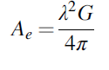
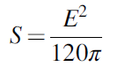
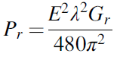
Antenna characteristics
3. Effective area
shows us that the capture ability of an antenna of given gain G grows proportionally as the square of the wavelength.
It holds for both transmitting and receiving antennas.
The power density is the radiated power divided by the surface area of the sphere. When the electric field strength E is known, the power density S is
Received power Pr can be found when field strength is known
Effective antenna area has some connection with the physical size of the antenna.
Short-range devices are often portable or are otherwise limited in size, and their antennas may have roughly the same dimensions, regardless of frequency
Power captured by the receiving antenna = capture area, or effective area, of the antenna × the power density at that location.

Slide 6
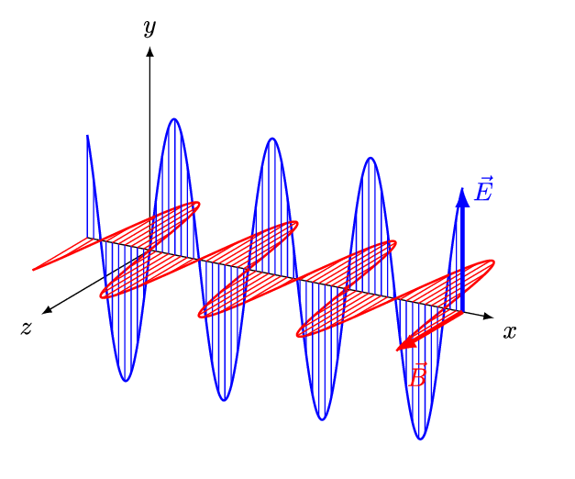
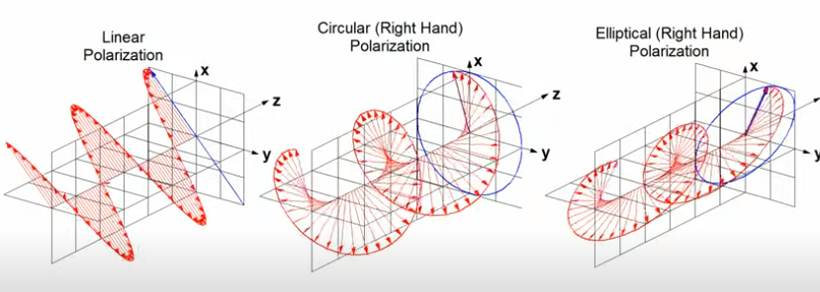
Propagation of EM wave

Slide 7
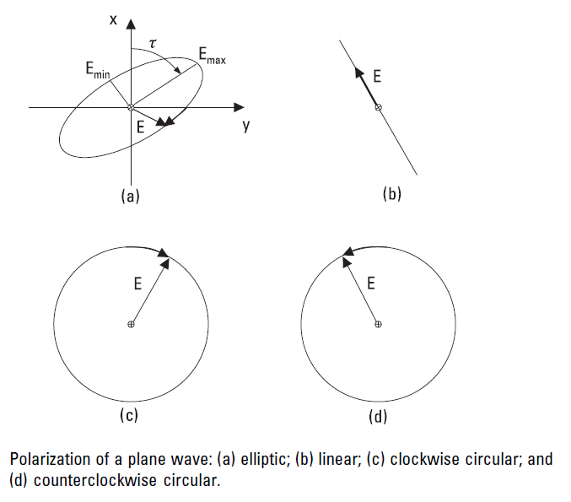
Antenna characteristics
4. Polarization
Electromagnetic radiation is composed of a magnetic field and an electric field.
In the far field, beyond around a wavelength from the antenna, these fields are at right
angles to each other, and both are in a plane normal to the direction of propagation.
The direction of polarization refers to the direction of the electric field in relation to
the earth.
1. Linear polarization is created by a straight wire antenna.
A wire antenna parallel to the earth is horizontally polarized and a wire antenna normal to the earth is vertically polarized.
2. Elliptical polarization :The electric and magnetic fields may rotate in their plane around the direction of propagation
created by perpendicular antenna elements being fed by RF signals on the communication frequency that are not in the same time phase with each other.
3. Circular polarization results when these elements are fed by equal power RF signals which differ in phase by 90°, which causes the electric (and magnetic) field to make a complete 360° rotation every period of the wave (a time of 1/frequency seconds)
Helical antenna, produce elliptic or circular polarization inherently, without having two feed points.

Slide 8
Antenna characteristics-Polarization-cont..
Two types of elliptical polarization, right hand and left hand, which are distinguished by the direction of rotation of the electric field
The polarization of a wave, or an antenna, is important for several reasons.
A horizontally polarized receiving antenna cannot receive vertically polarized radiation
from a vertical transmitting antenna, and vice versa.
Similarly, right-hand and left-hand circular antenna systems are not compatible.
Except for directional, line-of-sight microwave systems, the polarity of a signal may change during propagation between transmitter and receiver because of reflections.
Most short-range radio applications, a horizontal antenna will receive transmissions from a vertical antenna, for example, albeit with some attenuation.
The term cross polarization defines the degree to which a transmission from an antenna of one polarization can be received by an antenna of the opposite polarization.
Often, the polarization of a transmitter or receiver antenna is not well defined, such as in the case of a handheld device.
A circular polarized antenna can be used when the opposite antenna polarization is not defined
Cross polarization between antennas results in signal attenuation.
5.Bandwidth
Antenna bandwidth is the range of frequencies over which the antenna can operate while some other characteristic remains within a defined range.
It is related to the antenna impedance.

Slide 9
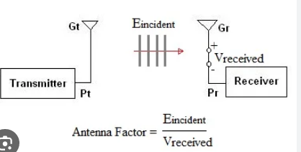
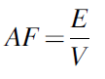
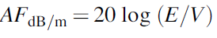
Antenna characteristics
A narrow bandwidth or high Q antenna will discriminate against harmonics and other spurious radiation and thereby will reduce the requirements for a supplementary filter
Changing proximity of nearby objects or the “hand effect” of portable transmitters can also cause a reduction of power or even a pulling of frequency, particularly in low-power transmitters.
6. Antenna factor
commonly used with calibrated test antennas to make field strength measurements on a test receiver or spectrum analyzer.
It relates the field strength to the voltage across the antenna terminals when the antenna is terminated in its specified impedance (usually 50 or 75 ohms).
where AF is the antenna factor in per m, E is the field strength in V/m, V is the load
voltage in V.

Slide 10
Antenna characteristics-summary
Antenna impedance
It is composed of three parts—radiation resistance, loss resistance, and reactance.
Antenna efficiency:
2. Directivity and gain
3. Effective area
Capture capability of antenna
4. Polarization
refers to the direction of the
electric field in relation to
the earth.
5.Bandwidth-range of frequencies over which the antenna can operate while some other characteristic remains within a defined range.
6. Antenna factor

Slide 11
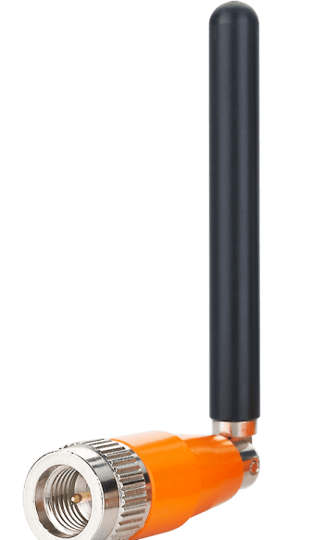
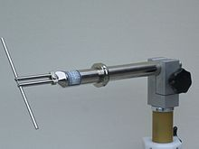
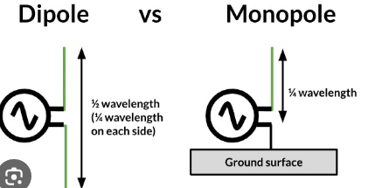
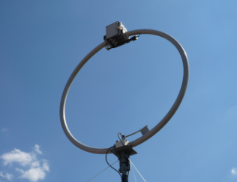
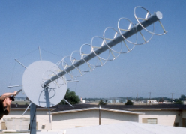
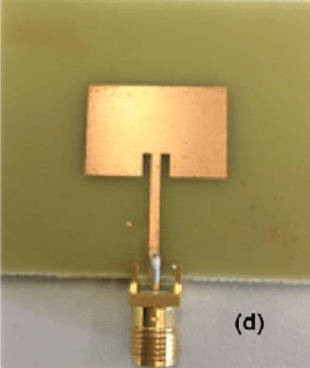
Types of Antenna

Slide 12
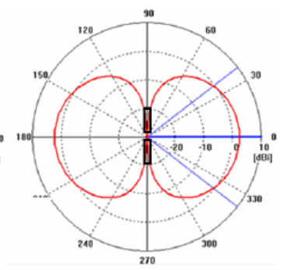
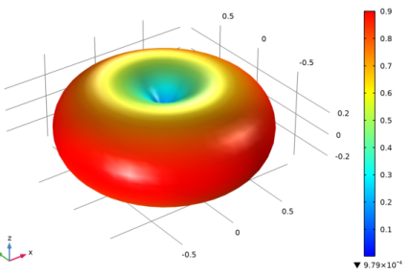
Types of Antenna
We review the characteristics of several types of antennas that are used in short-range radio devices.
Dipole
dipole is a wire antenna fed at its center.
length is one-half wavelength.
In free space, its radiation resistance is 73 ohms, but that value will vary somewhat in the presence of the ground or other large conducting objects.
usually mounted horizontally.
In free space, the radiation pattern of a horizontal half-wave dipole is similar to that of the small dipole
has a directivity of 1.64 or 2.15 dB in the horizontal plane perpendicular to the wire direction
presence of ground, or any other nearby conducting object, greatly influences the pattern.
When used indoors where there are a multitude of reflections from walls, floor, and ceiling, the horizontal dipole can give good results in all directions.
convenient to use because it is easy to match a transmitter or receiver to its radiation resistance.

Slide 13
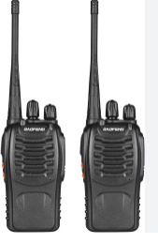
Types of Antenna
Dipole
It has high efficiency
Also, the antenna characteristics are not much affected by the size or shape of the device it is used with, and it doesn’t use a ground plane.
In spite of its many attractive features, the half-wave dipole is not commonly used with short-range radio equipment.
On the common low UHF unlicensed frequency bands, it is too large for many applications, particularly small portable devices.
TV & radio receivers.
2. Ground plane or monopole antenna
cordless telephones, Cellular, CB radios, walkie-talkies
dipole can be mounted vertically.
If we take one dipole element and mount it perpendicular to a large metal plate, then we don’t need the bottom element—a virtual element will be electrically reflected from the plate. This is called a monopole antenna.
When the metal plate is approximately one-half wavelength square or larger, the radiation resistance of the antenna is around 36 ohms, and a good match to the receiver or transmitter can be obtained.
In many short-range devices, a quarter-wave vertical element is used without a suitable ground plane, or, due to space restrictions, the radiating element may be less than one quarter wave long.

Slide 14
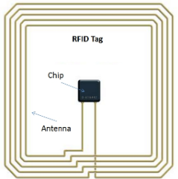
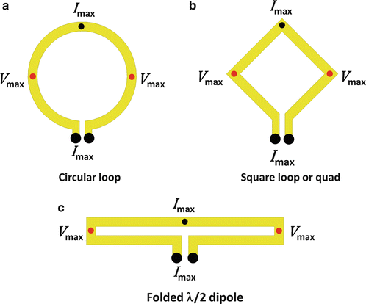
Types of Antenna
2. Ground plane or monopole antenna
In these cases, the radiation resistance is much lower than 36 ohms, and there is considerable capacitance reactance.
The electrical length can be increased and capacitive reactance reduced by winding the bottom part of the antenna element into a coil having several turns. In this way, the loss resistance is reduced and efficiency increased→ helical antenna
3. Loop antenna
popular for hand-held transmitters particularly because it can be printed on a small circuit board and is less affected by nearby conducting objects than other small resonant antennas.
Its biggest drawback is that it is very inefficient.
frequently used in small hand-held remote control transmitters on the low UHF frequencies.
The radiation resistance is generally below a tenth of an ohm and the efficiency under 10%.
radiation resistance and hence the efficiency could be raised by increasing the number of turns or the area of the loop.

Slide 15
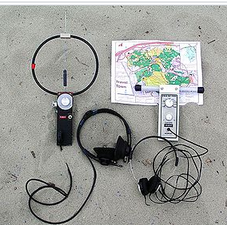
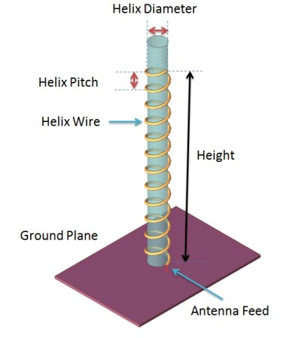
Types of Antenna
3. Loop antenna
Because of the low efficiency of the loop antenna, it is rarely used in UHF shortrange receivers.
An exception is pager receivers, which use low data rates and high sensitivity to help compensate for the low antenna efficiency.
One advantage of the loop antenna is that it doesn’t require a ground plane.
In low-power unlicensed transmitters, the low efficiency of the loop is not of much concern
4. Helical antenna
give much better results than the loop antenna, when radiation efficiency is important, while still maintaining a relatively small size compared to a dipole or quarter-wave ground plane.
made by winding stiff wire in the form of a spring, whose diameter and pitch are very much smaller than a wavelength, or by winding wire on a cylindrical form
This helical winding creates an apparent axial velocity along the spring which is much less than the velocity of propagation along a straight wire which is approximately the speed of light in space.

Slide 16
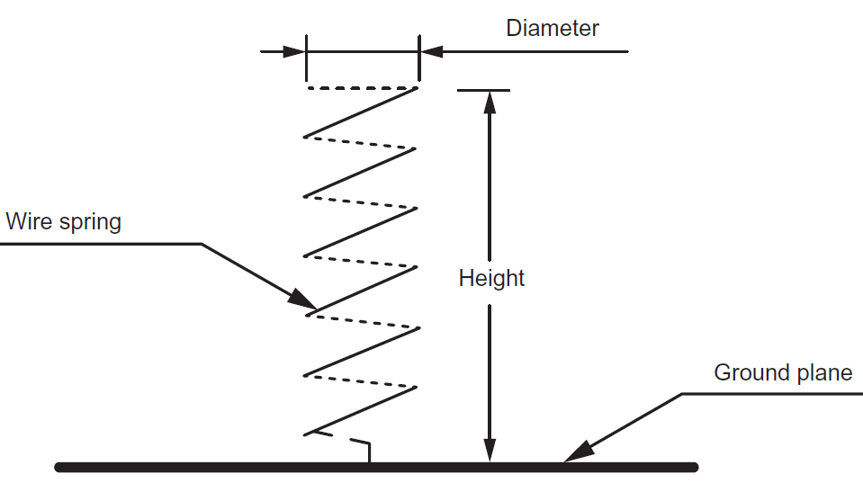
Types of Antenna
4. Helical antenna
Quarter wave on the helical spring will be much shorter than on a straight wire.
The antenna is resonant for this length, but the radiation resistance will be lower, and consequently the efficiency is less than that obtained from a standard quarter-wave
antenna.
Impedance matching to a transmitter or receiver is relatively easy.
Radiation from a helical antenna has both vertical and horizontal components, so its polarization is elliptic.
The helical antenna should have a good ground plane for best and predictable performance.
satellite & space probe communication

Slide 17
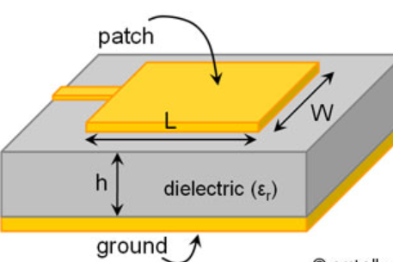
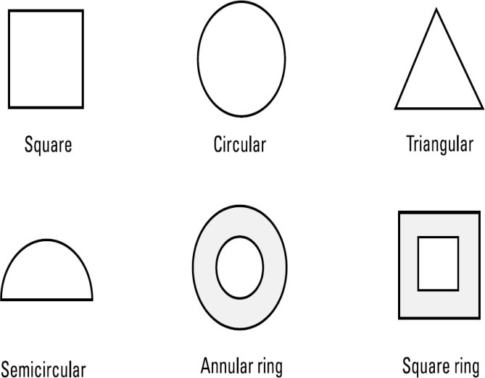
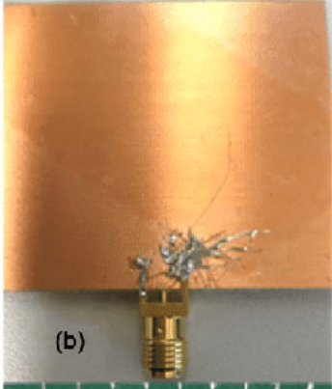
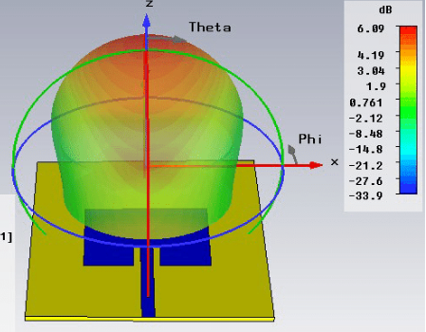
Types of Antenna
5. Patch antenna
convenient for microwave frequencies, specifically on the 2.4-GHz band and higher.
consists of a plated geometric form (the patch) on one side of a PCB, backed up on the opposite board side by a ground plane which extends beyond the dimensions of the radiating patch
Rectangular and circular forms are the most common, but other shapes—for example, a trapezoid are sometimes used.
Maximum radiation is perpendicular to the board.
A square half-wave patch antenna has a directivity of 7 to 8 dB.

Slide 18
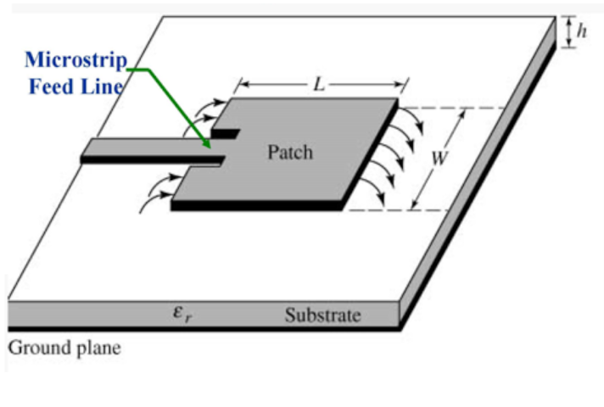
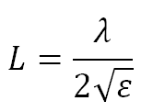
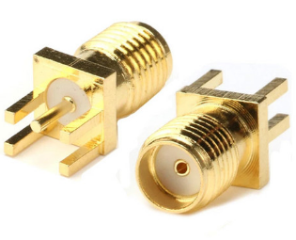
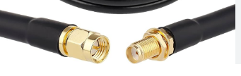
Types of Antenna
5. Patch antenna
It must actually be slightly less than a half wavelength because of the fringing effect of the radiation from the two opposite patch edges that are L apart and the ground plane.
As long as the feed is on the centerline, the two other edges don’t radiate.
The figure shows a microstrip feeder, which is convenient because it is etched on the board together with the patch and other component traces on the same side.
The impedance at the feed point depends on the width W of the patch.
In this way a 50-ohm coax transmission line can be connected directly to the underside of the patch antenna, with the center conductor going to the feed point through a via and the shield soldered to the ground plane.
The dimension L is approximately a half wavelength, calculated as half the free space wavelength (λ) divided by the square root of the effective dielectric constant (ε) of the board material.

Slide 19
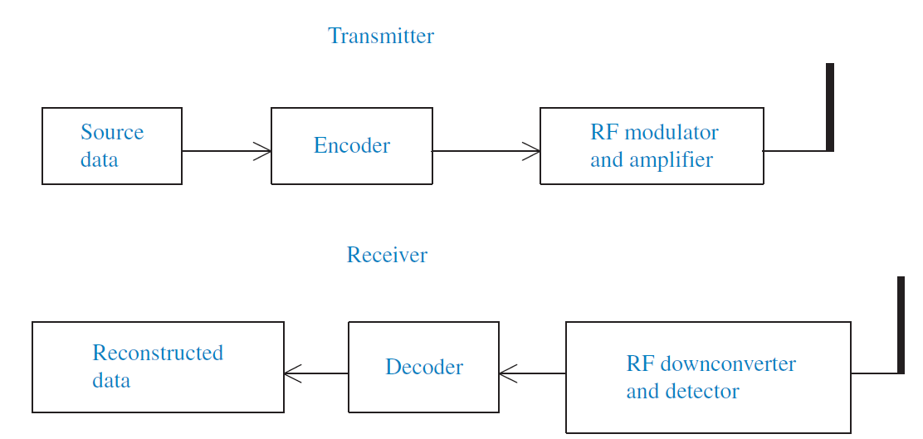
Radio Communication Link Diagram
The link transfers information originating at one location, referred to as source data, to another location where it is referred to as reconstructed data.

Slide 20
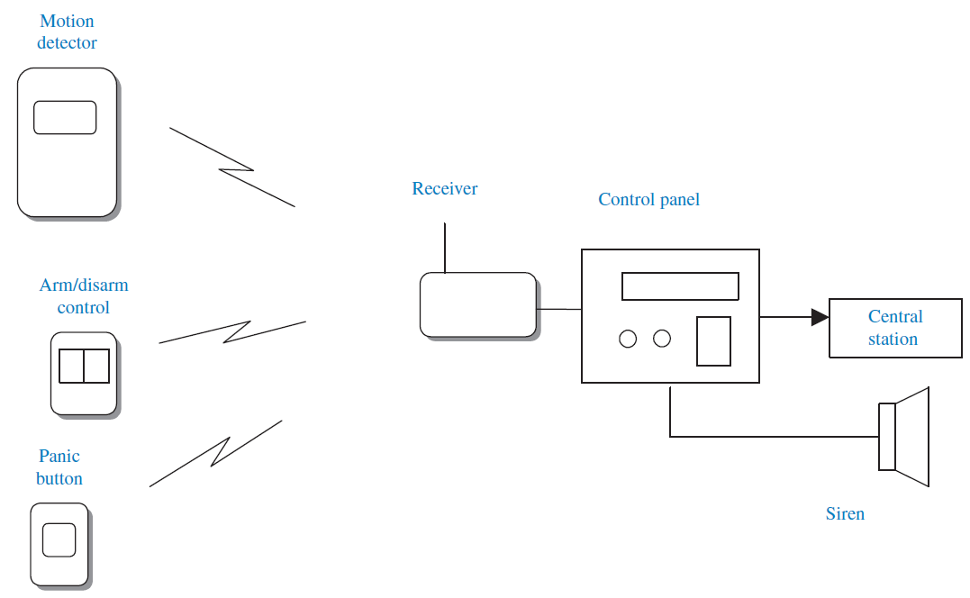
Radio Communication Link Diagram
A more concrete implementation of a wireless system, an intrusion detection system.

Slide 21
Baseband Data Format and Protocol
Change-of-state source data
Many short-range systems only have to relay information about the state of a contact.
This is true of the security system where an infrared motion detector notifies the control panel when motion is detected.
Another example is the pushbutton transmitter, which may be used as a panic button or as a way to activate and deactivate the control system, or a wireless smoke detector, which gives advance warning of an impending fire.
There are also what are often referred to as “technical” alarms—gas detectors, water level detectors, and low and high temperature detectors—whose function is to give notice of an abnormal situation.
All these examples are very low-bandwidth information sources.
Change of state occurs relatively rarely, and when it does, we usually don’t care if knowledge of the event is signaled tens or even hundreds of milliseconds after it occurs.
It would be possible to maintain this very low bandwidth by using the source data to turn on and off the transmitter at the same rate the information occurs, making a very simple communication link.
This is not a practical approach, however, since the receiver could easily mistake random noise on the radio channel for a legitimate signal and thereby announce an intrusion, or a fire, when none occurred.
Such false alarms are highly undesirable, so the simple on/off information of the transmitter must be coded to be sure it can’t be misinterpreted at the receiver.

Slide 22
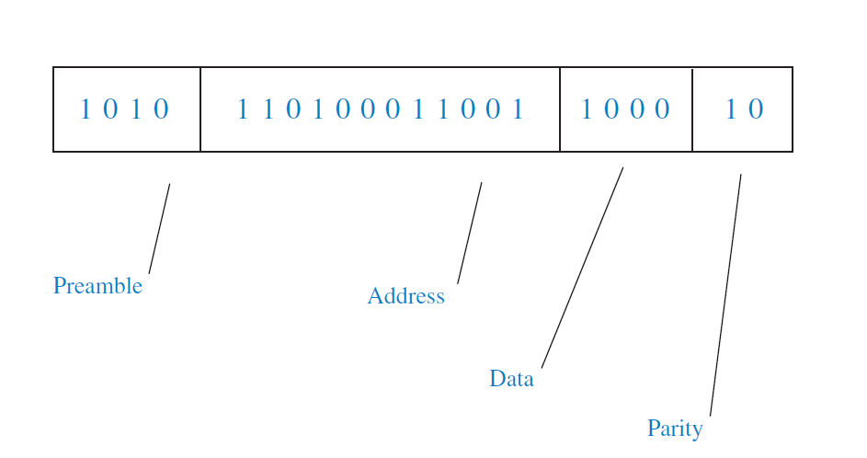
Baseband Data Format and Protocol
This is the purpose of the encoder→ creates a group of bits, assembled into a frame, to make sure the receiver will not mistake a false occurrence for a real one.
Message frame.
The example has four fields.
The first field is a preamble which conditions the receiver for the transfer of information and tells it when the message begins.
The next field is an identifying address. This address is unique to the transmitter and its purpose is to notify receiver from where, or from what unit, the message is coming.
The data field follows, which may indicate what type of event is being signaled, followed, in some protocols, by a parity bit or bits to allow the receiver to determine whether the message was received correctly.
Message frame

Slide 23
Code Hopping
Code hopping is a security technique commonly used in wireless communication systems to prevent unauthorized access and eavesdropping.
Code-hopping means that code contained in a transmitted message changes or 'hops' with every new transmission.
This method is variously called code rotation, code hopping, or rolling code addressing.
Frequency Hopping:
In a code hopping system, both the transmitter and receiver change their operating frequency (channel) multiple times during communication. This hopping between frequencies happens according to a predetermined hopping sequence known only to the legitimate devices.
Pseudorandom Sequence:
The hopping sequence appears random but is actually generated using a pseudorandom algorithm. This ensures that unauthorized parties cannot easily predict the sequence and intercept the communication.
Enhanced Security: By rapidly changing frequencies, the communication becomes more resilient against interference, jamming, and eavesdropping attempts.
Synchronization: Both the transmitter and receiver must stay synchronized to the hopping sequence. If they fall out of sync, communication might be disrupted. Proper synchronization mechanisms are critical to the effectiveness of the technique.
Applications:
remote keyless entry systems for cars,
garage door openers,
wireless alarm systems, and
secure wireless communication protocols.

Slide 24
Baseband coding
The form of the information signal that is modulated onto the RF carrier we call here baseband coding.
Digital systems
Once we have a message frame, composed as we have shown by address and data fields, the information must be formed into signal levels that can be effectively transmitted, received, and decoded.
This coding consists essentially of the way that zeros and ones are represented in the signal sent to the modulator of the transmitter.
These are the dominant criteria for choosing or judging a baseband code:
Timing.
The receiver must be able to take a data stream polluted by noise and recognize transitions between each bit.
The bit transitions must be independent of the message content—that is, they must be identifiable even for long strings of zeros or ones.
(b) DC content.
It is desirable that the average level of the message—that is, its DC level—remains constant throughout the message frame, regardless of the content of the message.

Slide 25
Baseband coding
(c) Power spectrum.
Baseband coding systems have different frequency responses.
A system with a narrow frequency response can be filtered more effectively to reduce noise before detection.
(d) Inherent error detection.
Codes that allow the receiver to recognize an error on a bit-by-bit basis have a lower possibility of reporting a false alarm when error detecting bits are not used.
(e) Probability of error.
Codes differ in their ability to properly decode a signal, given a fixed transmitter power.
This quality can also be stated as having a lower probability of error for a given signal-to-noise ratio.
(f) Polarity independence.
There is sometimes an advantage in using a code that retains its characteristics and decoding capabilities when inverted.
Certain types of modulation and demodulation do not retain polarity information. Phase modulation is an example.

Slide 26
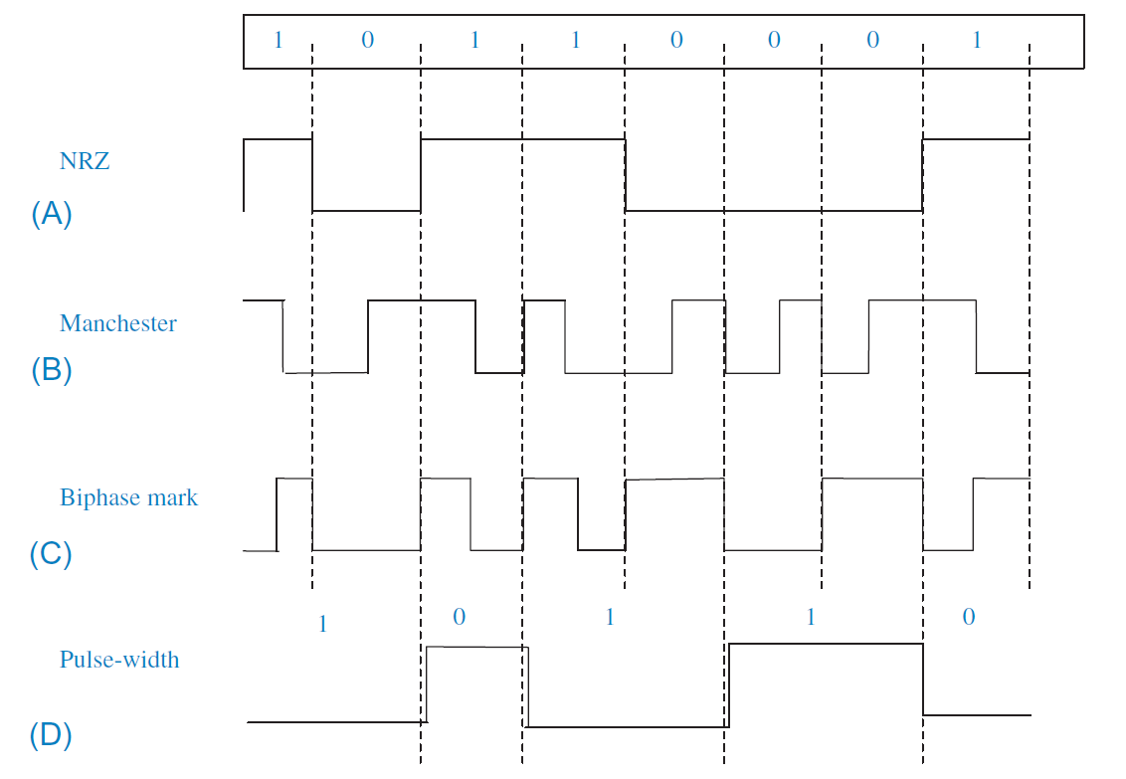
Baseband coding
1. Non-return to zero (NRZ)
This is the most familiar code, since it is used in digital circuitry and serial wired short-distance communication links, like RS-232.
However, it is rarely used directly for wireless communication.
Strings of ones or zeros leave it without defined bit boundaries, and its DC level is very dependent on the message content.
There is no inherent error detection. If NRZ coding is used, an error detection or correction field is imperative.

Slide 27
Baseband coding
2. Manchester code
A primary advantage of this code is its relatively low probability of error compared to other codes.
It is the code used in Ethernet local area networks.
It gives good timing information since there is always a transition in the middle of a bit, which is decoded as zero if this is a positive transition and a one otherwise.
The Manchester code has a constant DC component
Inverting the Manchester code turns zeros to ones and ones to zeros.
The frequency response of the Manchester code has components twice as high as NRZ code, so a low-pass filter in the receiver must have a cut-off frequency twice as high as for NRZ code with the same bit rate.

Slide 28
Baseband coding
3. Biphase Mark
This code is somewhat similar to the Manchester code, but bit identity is determined by whether or not there is a transition in the middle of a bit.
For biphase mark, a level transition in the middle of a bit (going in either direction) signifies a one, and a lack of transition indicates zero.
Biphase space is also used, where the space character has a level transition.
There is always a transition at the bit boundaries, so timing content is good.
A lack of this transition gives immediate notice of a bit error and the frame should then be aborted.
The biphase code has constant DC level, no matter what the message content
As with the Manchester code, frequency content is twice as much as for the NRZ code.
The biphase mark or space code has the added advantage of being polarity independent.

Slide 29
Baseband coding
4. Pulse width modulation
As shown in the figure, a one has two timing durations and a zero has a pulse width of one duration.
The signal level inverts with each bit so timing information for synchronization is good. There is a constant average DC level.
Since the average pulse width varies with the message content, in contrast with the other examples, the bit rate is not constant.
This code has inherent error detection capability.

Slide 30
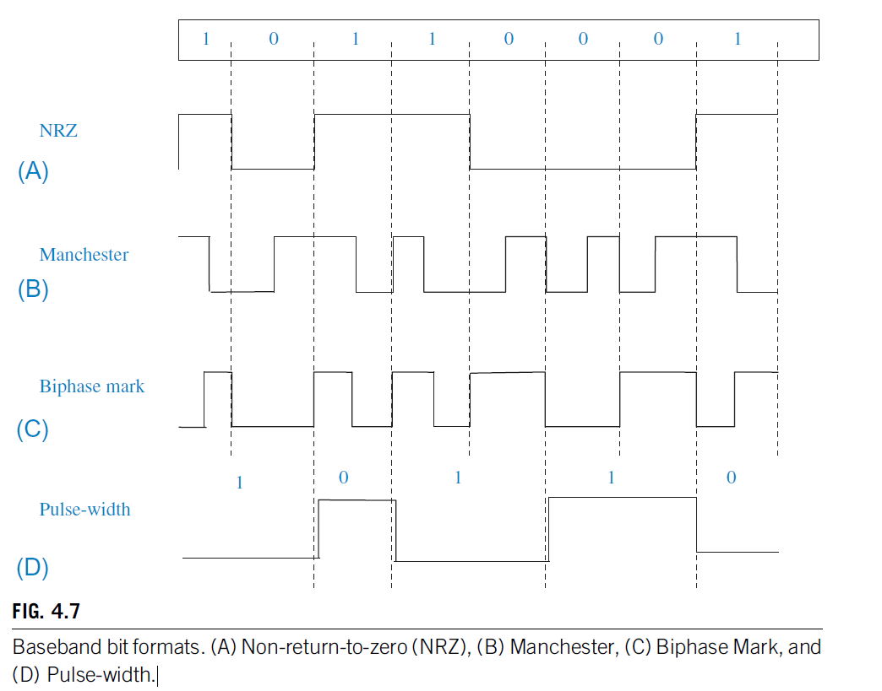

Slide 31
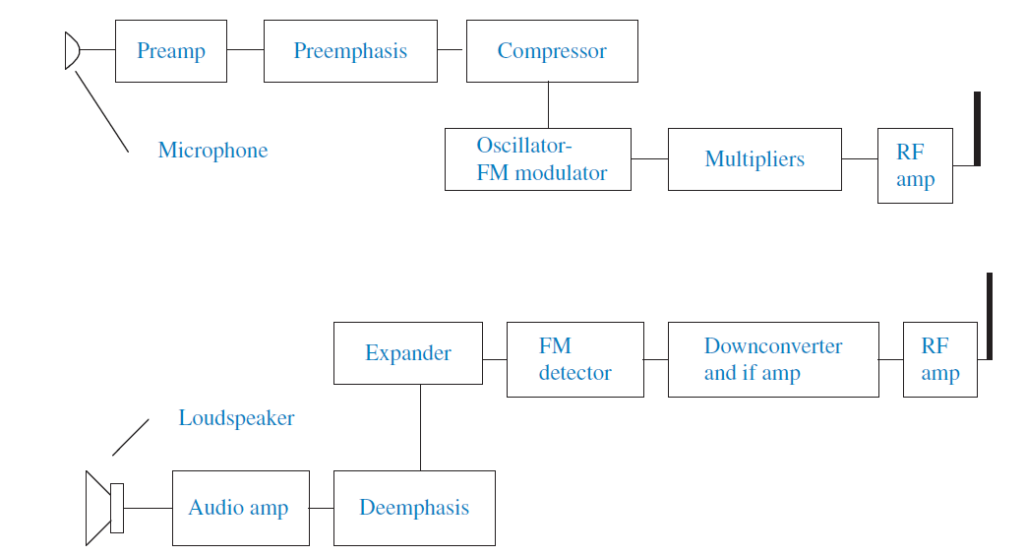
Analog baseband conditioning-Wireless microphone system.
Wireless microphones and headsets are examples of short-range systems that must maintain high audio quality over the vagaries of changing path lengths and indoor environments, while having small size and low cost.
To help them achieve this, they have a signal conditioning element in their baseband path before modulation.
Two features used to achieve high signal-to-noise ratio over a wide dynamic range are pre-emphasis/de-emphasis and compression/expansion.

Slide 32
Analog baseband conditioning-Wireless microphone system.
The transmitter audio signal is applied to a high-pass filter (pre-emphasis) which increases the high frequency content of the signal.
In the receiver, the detected audio goes through a complementary low-pass filter (de-emphasis), restoring the signal to its original spectrum composition.
However, in so doing, high frequency noise that entered the signal path after the modulation process is filtered out by the receiver while the desired signal is returned to its original quality.
Compression of the transmitted signal raises the weak sounds and suppresses strong sounds to make the modulation more efficient.
Reversing the process in the receiver weakens annoying background noises while restoring the signal to its original dynamic range.

Slide 33
Choice of RF frequency and bandwidth
Important factors to consider when determining the radio frequency of a short-range system:
1. Telecommunication regulations
When a device is to be marketed in several countries and regions of the world, →choose a frequency that can be used in the different regions, or at least frequencies that don’t differ very much so that the basic design won’t be changed by changing frequencies
The UHF frequency bands are usually the choice for wireless alarm, medical, and
control systems. The bands that allow unlicensed operation don’t require rigid frequency
accuracy.
Various components—SAWs and ICs—have been specially designed for these bands and are available at low prices→ simple designs and low cost.
Complete RF transmitter and receiver modules covering the most common UHF frequencies, among them 315 MHz and 902 to 928 MHz (the United States and Canada), and 433.92 MHz band and 868 to 870 MHz (European Community).
2. Antenna size
Antenna size may be important in certain applications, and for a given type of antenna, its size is proportional to wavelength, or inversely proportional to frequency.
efficient built-in antennas are easier to achieve in small devices at short wavelengths.

Slide 34
Choice of RF frequency and bandwidth
3. Cost
directly proportional to increased frequency
Interference
Natural and man-made background noise is higher on the lower frequencies.
On the other hand, certain frequency bands available for short-range use may be very congested with other users, such as the ISM bands.
Where possible, it is advisable to choose a band set aside for a particular use, such as the 868–870 MHz band available in Europe.
5. Propagation characteristics
must be considered in choosing the operating frequency.
High frequencies reflect easily from surfaces but penetrate insulated barriers less readily than lower frequencies.

Slide 35
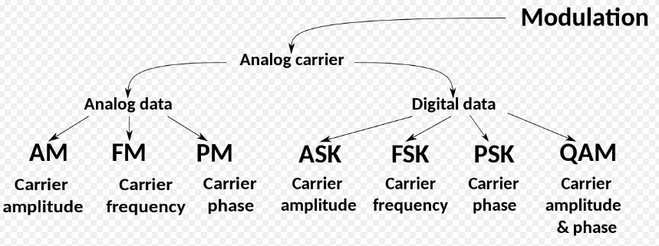
Modulation and its types
Modulation is the process of varying a carrier signal's properties, such as amplitude, frequency, or phase, to carry information.
Modulation is used to transmit data over a communication channel efficiently.
Amplitude modulation (AM) and frequency modulation (FM), known from commercial broadcasting
Third class of modulation is phase modulation, not used in broadcasting, but its digital counterpart is commonly used in high-end, high-data-rate digital wireless communication

Slide 36
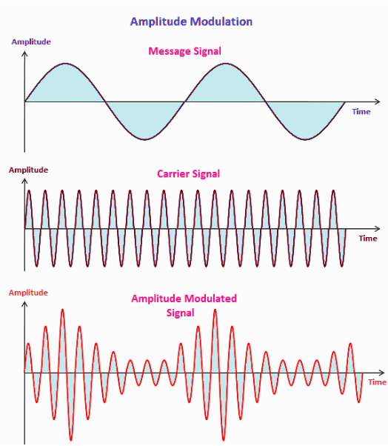
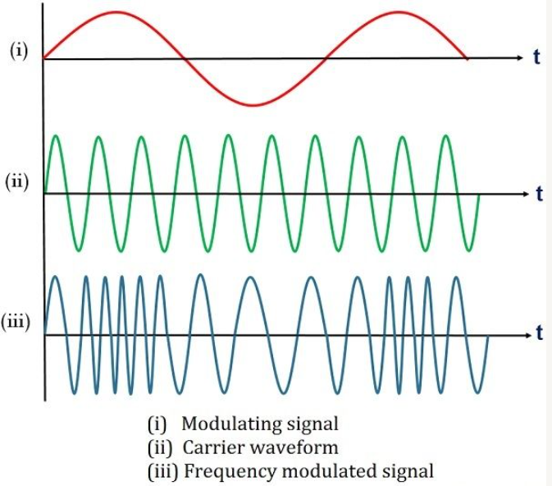
Analog modulation

Slide 37
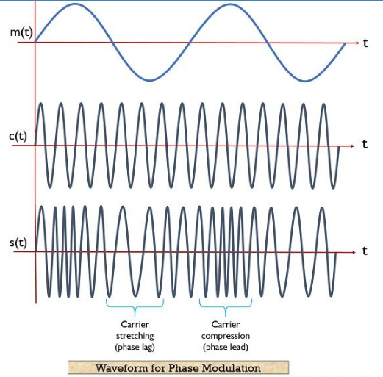
Analog modulation

Slide 38
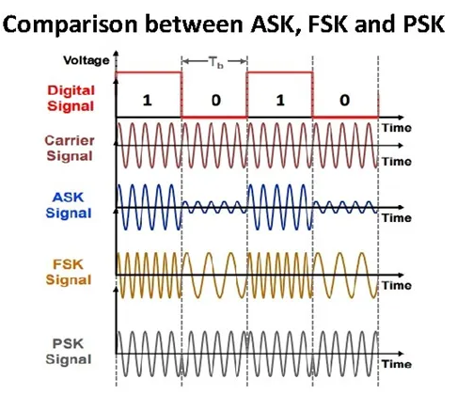
Digital modulation
Whereas in ASK and FSK the amplitude and frequency are varied according to the digital source data, in PSK it is the phase of the RF carrier that is varied.
Digital AM is referred to as ASK—amplitude shift keying—and sometimes as OOK—on/off keying.
FSK is frequency shift keying, the parallel to FM.

Slide 39
Modulation for digital event communication
For short-range digital communication we’re not interested in high fidelity, but rather high sensitivity.
Other factors for consideration are simplicity and cost of modulation and demodulation.
Reasons for choosing one form of modulation or the other:
An analysis of error rates versus bit energy to noise density shows that there is no
inherent advantage of one system, ASK or FSK, over the other.
In low-cost security systems, ASK is the simplest and cheapest method to use.
For this type of modulation we must just turn on and turn off the radio frequency output in accordance with the digital modulating signal.
Detection in the receiver is also simple.
If we take advantage of the maximum allowed peak power, FSK is the proper choice, since for a given peak power, the average power of the ASK transmitter will always be less.
Based on analysis of the effect of different types of interference→ASK, which does not completely shut off the carrier on a “0” bit, is marginally better than FSK.

Slide 40
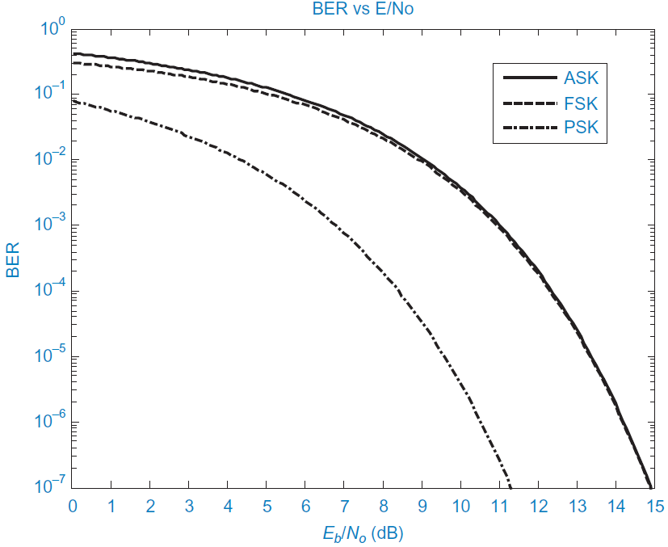
Continuous Digital Communication
common way to compare performance of the different systems is by curves of bit error rate (BER) versus the signal-to-noise ratio, expressed as energy per bit divided by the noise density
ASK is easy to generate and detect, its bit error rate performance is essentially the same as for FSK.
Best type of modulation to use from the point of view of lowest bit error for a given signal-to-noise ratio (E/No) is PSK.
FSK is usually the modulation of choice for many systems.
FSK has slightly more complexity than ASK, and that’s probably why it isn’t used in all short-range digital systems.

Slide 41
Advanced Digital modulation
Two leading demands of wireless communication
higher data rates
better utilization of the radio spectrum→ translates to higher speeds on narrower bandwidths.
At the same time, much of the radio equipment is portable and operated by batteries. So what is needed is:
• high data transmission rates
• narrow bandwidth
• low error rates at low signal-to-noise ratios
low power consumption
Breakthroughs have occurred with the advancement of digital modulation and coding systems.
Most of the high-data-rate bandwidth-limited channels use multiphase PSK or QAM.
The diagram shown below is the basis of what is called vector modulation, IQ modulation, or quadrature modulation. “I” stands for “in phase” and “Q” stands for “quadrature.”
The basis for quadrature modulation is the fact that two independent data streams
are simultaneously modulated on a carrier wave of a given frequency.
This is possible if each data stream modulates coherent carriers whose phases are 90 degrees apart.
QAM(Quadrature Amplitude Modulation)

Slide 42
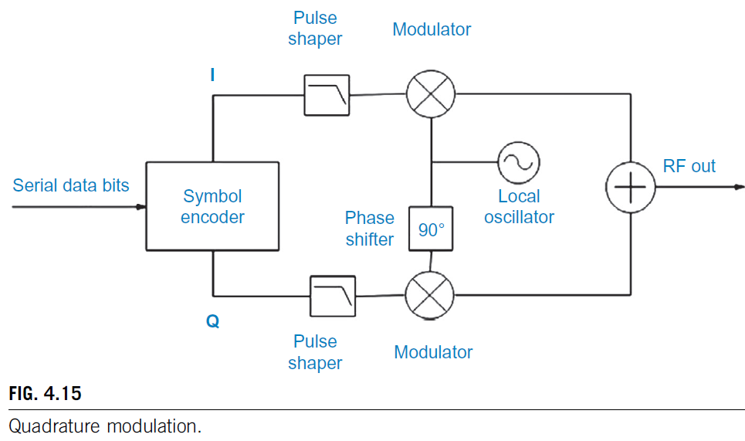
Advanced Digital modulation-QAM
Each of these carriers is created from the same source by passing one of them through a 90-degree phase shifter.
The symbol encoder block is a serial to parallel converter and symbol mapper.
It takes n data bits and for each of the possible 2^n binary values of the symbol, it sends in-phase “I” and quadrature “Q” levels to the modulators whose outputs are summed to give a distinctive magnitude and phase to the symbol RF output.
The pulse shaper filters smooth the transitions between symbols to restrain the bandwidth.

Slide 43
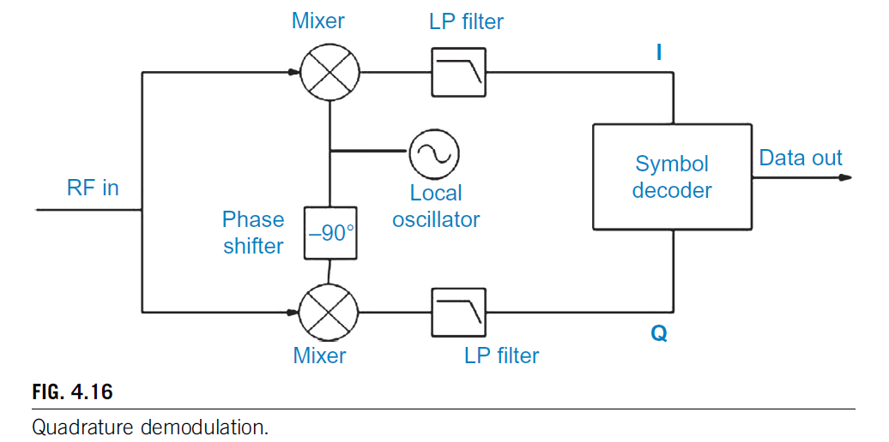
Advanced Digital modulation-QAM
The receiver, by reversing the process used in the transmitter can reproduce the bit sequence of the transmitted symbol.
Down conversion mixers switched by quadrature versions of the local oscillator output produce in-phase and quadrature baseband signals after lowpass filtering.
The symbol decoder performs the opposite function of the transmitter symbol encoder and outputs the binary data corresponding to the values of I and Q of the symbol.

Slide 44

Advanced Digital modulation-QAM
The magnitude and phase of each possible state of a carrier symbol in response to the modulation is shown on a vector or constellation diagram
An even number of bits per symbol, (b = 4, 6, 8, …) are applied to the I and Q paths to create a carrier signal with 2^b states of given amplitude and phase.
For example, 4 bits per each carrier vector symbol creates 16 combinations of amplitude levels and phase. This type of modulation is called QAM, and in this example, 16-QAM, 4 data bits are transmitted in the same time and bandwidth
Common in digital communication, including Wi-Fi and digital television

Slide 45

Spread Spectrum
Another aspect of digital modulation that is used in a number of short-range wireless applications—spread-spectrum modulation
Allowed the telecommunication authorities to permit higher transmitter powers because spread-spectrum signals can coexist on the same frequency bands as other types of authorized transmissions without causing undue interference or being unreasonably interfered with.
Fig. 4.19A shows the spread-spectrum signal spread out over a bandwidth much larger than the narrow-band signals. spreading the transmitted power over a wide frequency band greatly reduces the signal power in a narrow bandwidth and thus the potential for interference.
Fig. 4.19B shows how spread-spectrum processing reduces interference from adjacent signals. The despreading process concentrates the total power of the spread-spectrum signal into a narrow-band high peak power signal, whereas the potentially interfering narrow-band signals are spread out so that their power in the bandwidth of the desired signal is relatively low.

Slide 46
Spread Spectrum
Advantages
• Allows permitting higher power for nonlicensed devices
• Reduces co-channel interference—good for congested ISM bands
• Reduces multipath interference
• Resists intentional and unintentional jamming
• Reduces the potential for eavesdropping
• Permits code division multiplexing of multiple users on a common channel.

Slide 47

Spread Spectrum
The methods for spreading the bandwidth of the spread-spectrum transmission are:
1. In frequency hopping spectrum FHSS, the RF carrier frequency is changed relatively rapidly at a rate of the same order of magnitude as the bandwidth of the source information (analog or digital), but not dependent on it in any way. At least several tens of different frequencies are used, and they are changed according to a pseudo-random pattern known also at the receiver.
2. The direct-sequence spread-spectrum DSSS signal is modulated by a pseudo-random digital code sequence known to the receiver.
The performance of all types of spread-spectrum signals is strongly related to a property called process gain.
It is this process gain that quantifies the degree of selection of the desired signal over interfering narrow-band and other wide-band signals in the same passband.
Process gain is the difference in dB between the output S/N after despreading and the input S/N to the receiver:

Slide 48


Spread Spectrum types- FHSS
FHSS can be divided into two classes—fast hopping and slow hopping.
A fast hopping transmission changes frequency one or more times per data bit (or symbol
if there are multiple data bits per symbol).
In slow hopping, several bits are sent per hopping frequency. Slow hopping is used for fast data rates. Frequency hopping as a function of time is shown in Fig. 4.20. The spectrum of a frequency-hopping signal looks like Fig. 4.21.

Slide 49

Spread Spectrum types- FHSS
Both transmitter and receiver local oscillator frequencies are controlled by frequency synthesizers.
The receiver must detect the beginning of a transmission and synchronize its synthesizer to that of the transmitter.
When the receiver knows the pseudo-random pattern of the transmitter, it can lock onto the incoming signal and must then remain in synchronization by changing frequencies at the same time as the transmitter.
Once exact synchronization has been obtained, the IF frequency will be constant and the signal can be demodulated.

Slide 50


Spread Spectrum types- DSSS
A pseudo random spreading code modulates the Txer carrier frequency, which is then modulated by data.
The elements of this code are called chips.
The frequency spectrum created is shown above.
The required bandwidth = width of the major lobe= twice the chip rate.
Due to the wide bandwidth, the signal-to- noise ratio at the receiver input is very low, often below 0 dB.
-----------------------------------------------------------------------------------------------------------------------
The Rxer multiplies the replica of the transmitter’s pseudo-random spreading code with the Rxer LO and the result is mixed with the incoming signal.
When the Txer and Rxer spreading codes are same and are inphase, a narrow band IF signal results that can be demodulated in a conventional fashion.

Slide 51

Spread Spectrum types- DSSS
Two stages to synchronize Txer and Rxer pseudo random codes---acquisition and tracking.
Inorder to acquire a signal, Rxer multiplies the known expected code with incoming RF signal→ ouput is random noise when signals other than desired signal exist in channel.
When desired signal is present it must by synchronized precisely inphase with Rxer code sequence to achieve a strong output.
In synchronization, tracking, keeps the txed and rxed code bits aligned for complete duration of message.
Relative advantages of FHSS and DSSS
FHSS can be designed with less power consumption than DSSS
DSSS provide higher data rate with less redundancy
Acquisition time is lower in FHSS
FHSS have high interference immunity
DSSS have more flexibility

Slide 52
OFDM—orthogonal frequency division multiplex.
Offers improved spectral efficiency, good performance in urban and indoor high multipath environments, and relative simplicity
Based on the use of mathematical Fourier transform manipulations, OFDM forms the basis of diverse wideband communications technologies, among them:
• IEEE 802.11 (Wi-Fi)
• IEEE 802.16 (WiMAX)
• Long Term Evolution Cellular (LTE)
• Terrestrial Digital Video Broadcasting (DVB-T)
• Digital Audio Broadcast (DAB)
• Asymmetric Digital Subscriber Line (ADSL)
• Power Line Networking (HomePlug)
OFDM is advantageous →high bit rate communication in a multipath Environment.
Intersymbol interference, often a problem in indoor systems, is essentially eliminated by posing a guard interval in front of each OFDM symbol.

Slide 53

OFDM
The OFDM spectrum is flat-topped, with transmission power distributed equally over the bandwidth, and shows sharp attenuation outside of the passband.
The DSSS spectrum, on the other hand, has a rounded main lobe with highest power density around the carrier frequency and reduced power density approaching the passband edges. It also has minor lobes which must be filtered out.
In the transmitter, the high rate symbol stream is demultiplexed in a serial to parallel converter (S-P) and the symbols in each of the low rate parallel streams are applied at the
start of each symbol time to the inverse fast Fourier transform block IFFT.
The parallel output of the IFFT becomes a baseband time domain signal at the output of the
parallel to serial converter block (P-S).
The baseband symbol length is increased by the cyclic prefix (CP) and upconverted in a balanced modulator to the transmitted pass band.

Slide 54

OFDM
In the receiver, the OFDM signal is down converted in the demodulator, and synchronized to symbol and frame timing.
The cyclic prefix is removed and after serial to parallel conversion (S-P), the time samples within an OFDM period are transformed by the FFT block to frequency domain symbols.
An equalizer compensates for the flat fading over the communication channel and
then a parallel to serial converter restores the original symbol stream.

Slide 55

RFID-transceiver, Design issues for RFID
RFID devices are not communication devices but involve interrogated transponders.
Instead of having two separate transmitter and receiver terminals, an RFID system consists of a reader that sends a signal to a passive or active tag and then receives and interprets a modified signal reflected or retransmitted back to it.
One or more tags or smart cards are interrogated by the reader to obtain the ID of each and the data are sent to a host application. Some types of tags/cards may be written to as well. Other tag devices include sensors whose outputs are read to the host.
Interrogators are responsible for remotely powering the tags (in passive and semi-passive systems), establishing the bidirectional data flow between themselves and the tags, and performing analog to digital as well as digital to analog signal conversion.

Slide 56
RFID-transceiver, Design issues for RFID
Applications:
• Aircraft identification.
A terrestrial terminal, radar for example, transmits a beam in the direction of an aircraft. A transponder in the airborne vehicle responds by transmitting an identification code to the initiating terminal, which can be used to mark a radar screen blip, and, in wartime, signify friend or foe.
• Roadway toll collection. A signal from an overhead transmitter on a toll road activates a transponder mounted on a vehicle windshield which transmits the car ID to a toll station receiver for billing purposes.
• Inventory control. Tags on product cartons in a warehouse each reflect a signal to
a handheld reader identifying the contents of the box.
• Animal husbandry. Embedded tags in cows are read by RFID readers when the animals come for milking for the purpose of acquiring statistics on the milk output of each individual cow.
The reader has a conventional transmitter and receiver.
The tag itself is special for this class of applications.
It may be passive, receiving its power for retransmission from the signal sent from the reader, or it may have an active receiver and transmitter and embedded long-life battery.
RFID tag has no signal inputs or outputs, but just transmits a response of internal information upon receipt of a trigger transmission.

Slide 57
RFID-transceiver, Design issues for RFID
The tag may incorporate an external sensor element whose measurement values can be read in a similar manner to the tag’s internal memory.
A read-write tag has memory that can be modified by the reader.
Operation
The reader transmits an interrogation signal, which is received by the tag.
The tag may alter the incoming carrier signal in some unique manner and reflect it back, or its transmitting circuit may be triggered to read its ID code residing in memory and to transmit this code back to the receiver.
Active tags have greater range than passive tags. If the tag is moving in relation to the receiver, such as in the case of toll collection on a highway or parts moving on a conveyer belt, the data transfer must take place fast enough to be complete before the tag is out of range.
Design issues:
• Tag orientation is likely to be random, so tag and reader antennas must be designed to give the required range for any orientation.
• Multiple tags within the transmission range can cause return message collisions. One way to avoid this is by giving the tags random delay times for response, which may allow several tags to be interrogated at once.
• Tag data must be coded to prevent misreading.

